Slide 1

Investing in Women Smallholders
Ruchi Tripathi
Head of Right to Food
ActionAid International
June 2011

Slide 2
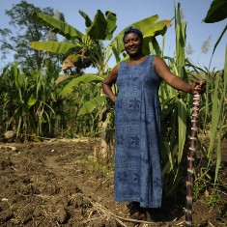
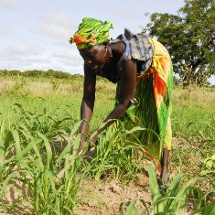
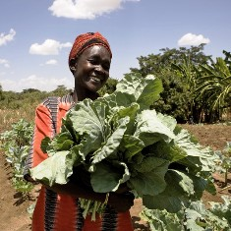
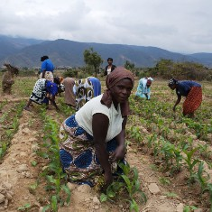
Gender gap in agriculture
Women smallholders comprise an average of 43 percent of the agricultural labour force of developing countries. The female share of the agricultural labour force ranges from about 20 percent in Latin America to almost 50 percent in Eastern and Southeastern Asia and sub-Saharan Africa
Despite this rural women rarely receive any attention in agricultural policies, programmes and budget allocations.
Women own only 1% of the land in Africa; receive only 7% of extension services and 1% of all agricultural credit. If women farmers in Africa had the same access to land as men, they would increase their farm productivity by up to 20%.
Closing the gender gap in agriculture could reduce the number of hungry people in the world by 12-17 % thereby reducing the number of hungry by at least 100 million people (FAO 2011)

Slide 3
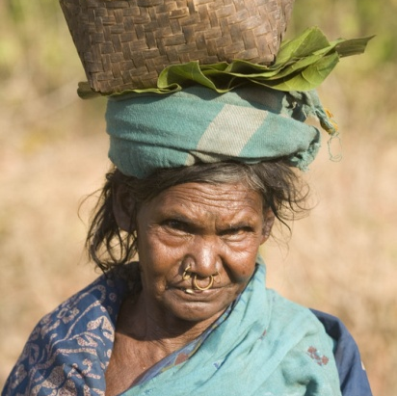
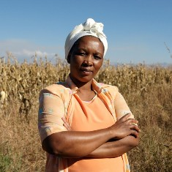
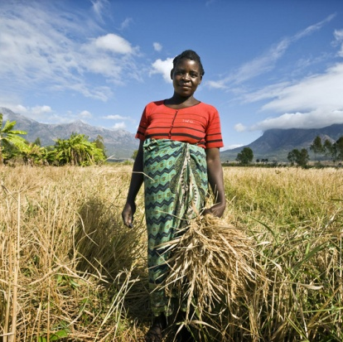
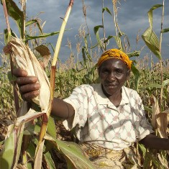
Multiple constraints and responsibilities of women smallholders
Firstly women tend to be invisible to policy makers, which is born out of a lack of recognition of their role as ‘productive’ farmers, and a lack of recognition of their unpaid farm work
In addition, they bear a disproportionate burden of care and reproductive roles within the family and community.
They are also deprived of access to markets, key assets, and inputs, and are frequently excluded from decision-making.
Women are also disproportionately impacted by poverty and hunger - including having lower access to education and health care facilities compared to men.

Slide 4
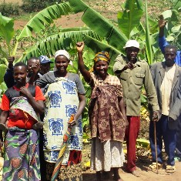
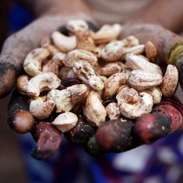
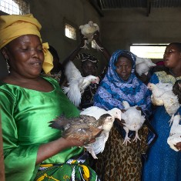
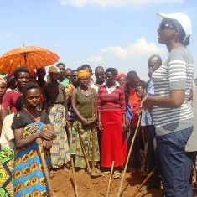
Need for an integrated approach
An integrated and holistic approach should:
  Recognise women as both farmers and food producers
  Recognise their productive and reproductive roles.
Food security programmes that address these separately fail to see the linkages and trade-offs that come with only seeing women as farmers or only as carers/food providers.
Such approach can help to empower women, giving them more control over their time and resources and allowing them to challenge public policies.

Slide 5
Support for women smallholders should include¹
Securing poor women farmers’ access to and control over land
Gender appropriate farming inputs
Access to financial services including social transfers
Access to clean and stable source of water
Appropriate extension services and training
Appropriate research and technology
Appropriate marketing facilities
¹ Adapted from ActionAid. 2011. What Women Farmers Need: A blueprint for action. Johannesburg: ActionAid. Available at: http://www.actionaid.org/publications/what-women-farmers-need-blueprint-action

Slide 6
Strategies to address gender specific constraints and empower women smallholder farmers²
Active participation of women in collective action (and solidarity with women who cant join the groups)
Improved access to and management of productive resources (individual and collective) for women
Enhanced contributions by women to household revenues (and control over these resources)
Optimised time and resources spent in care and reproductive activities by women – policies and interventions must recognise women’s paid and unpaid work, including unpaid care work
² Adapted from ActionAid. Forthcoming. The Long Road from Household Food Security to Women's Empowerment - Signposts from Bangladesh and The Gambia. Johannesburg: ActionAid.

